Slide 1
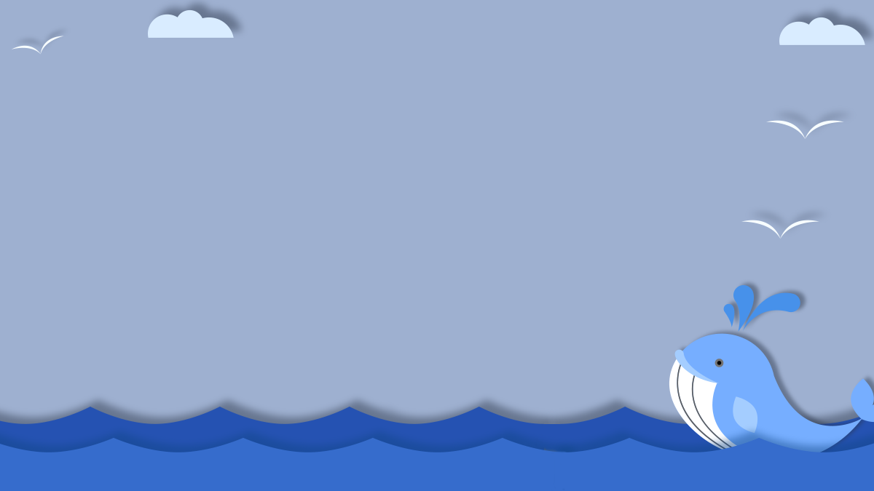
Humpback Whale Identification
Jasmine Cao, Melissa Cheung, Adan Constanzo, Mher Oganesyan, Smitkumar Kaushikkumar Patel

Slide 2

Purpose
Proving better surveillance
Why?
Human intervening
Warm Oceans
Migration
How?
Images use from Happywhale’s database
Analyzing
Identifying
Notes:
Whales are being treated by tougher environments as human intervene from the hunt for whales and oceans becoming warmer. A solution for the whales were to migrate to different locations in the sea. In order to aid the conservation efforts and provide a general surveillance system to the monitor the ocean activity this challenge from kaggel arised. For this kaggle competition, we are gather images from Happywahle’s database to classify specific species of whales for surveillance purposes. For the past 40 years, most of analyzing and identify whales have been done manually by individual scientist; leaving a majority of data unused and underutilized. This competition enables the use of helping a scientific community, make use of their data, and provide better survancle for the ocean.

Slide 3
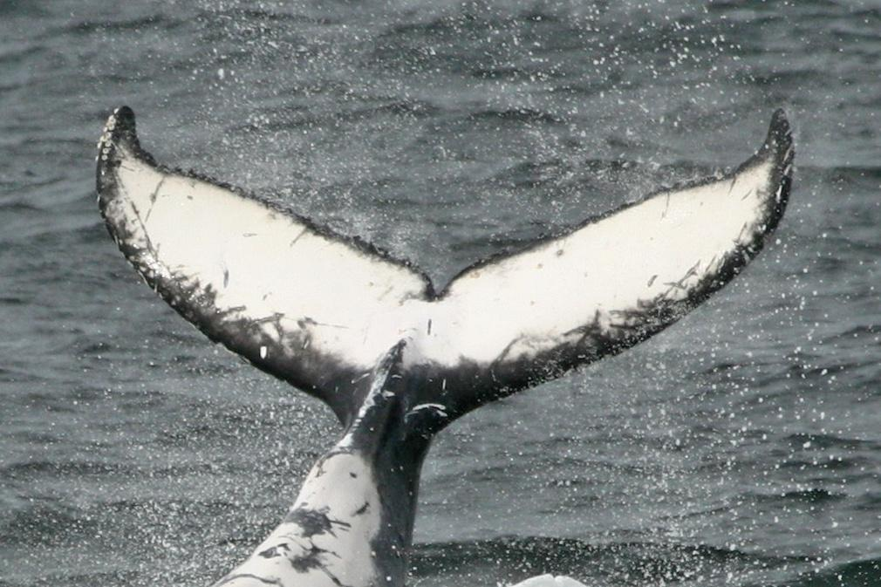
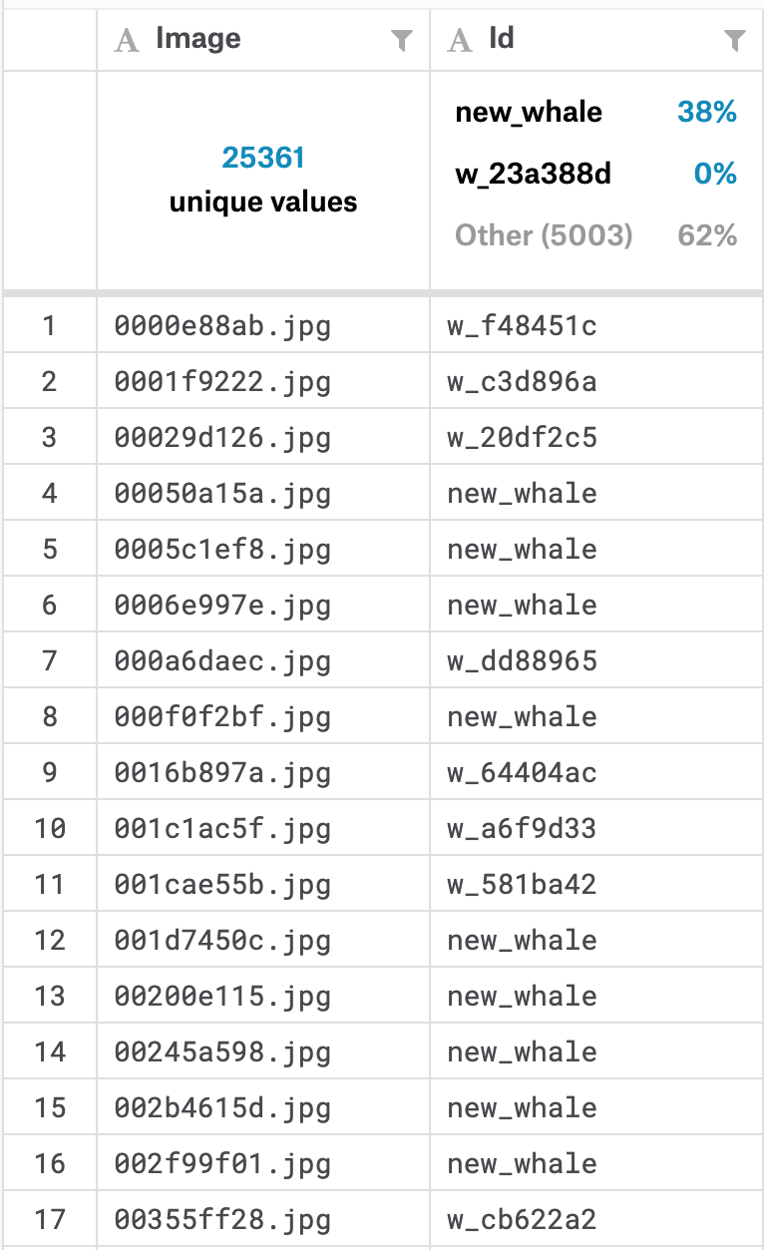
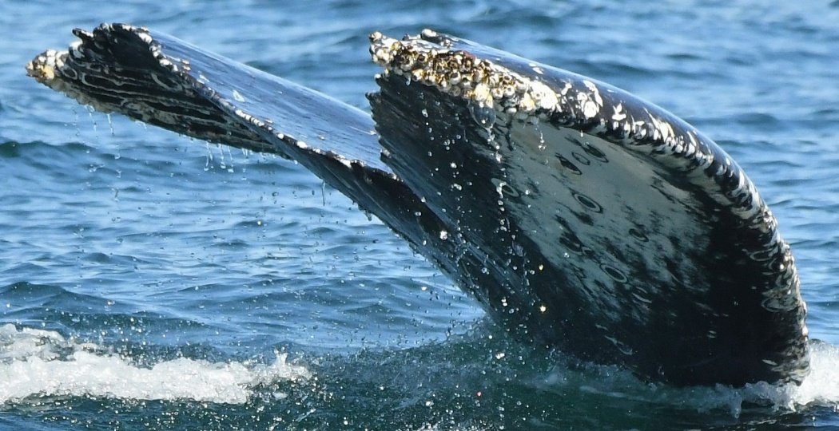
Dataset
25k Images Total
5k Unique Whale Species
9.6k Whales Unidentified
Different Dimension
RGB
Grayscale
Given train.csv
Two Columns
Image Name
Whale Identification
Notes:
The data set consist of over 25,361 images gathered from research institutions and public contributors. Out of the 25,361 images there are over 5,005 unique whale species to be classified. And from the 25,361 images there are around 9,664 whales unidentified. All images come in different dimensions and might be RGB or grayscale. There is a train.csv that includes two columns, image name and whale identification.

Slide 4

Modification to the Challenge
Reduce Complexity
Classifying
5k Whales Top 10 Whales
Thank You Dr. Mohammad Pourhomayoun!
Notes:
Since we are giving multiple images to classify, Dr. Mohammad Pourhomayoun gave us special permission to reduce the complexity of the project. Instead of classifying over 5,005 whales we will be only classifying the top 10 whales in our dataset.

Slide 5
Pre-Processing
Data Cleaning
Large portion of dataset is labeled as “new_whale,” meaning unknown species
9664 images labeled as “new_whale” were removed (38% of dataset)
Used top ten recurring species (570 samples)
Image Size Reduction
Dimensions for each image was inconsistent
Images were resized to 100x100 pixels
Scaled the aspect of image to prevent loss of information
Augmenting Images
Increase image occurrence from 570 3306
Images copies consisted of: rotating, shifting, horizontal flipping, and zooming in on image
Notes:
They’re in the other slide

Slide 6
Pre-Processing Cont.
Preparing our Features
Features consisted of pixel and RGB values of images
Images imported using keras.preprocessing.image
Images condensed to multidimensional array of 100x100x3, then appended to training/testing set
Each image divided by 255 for RGB
Preparing our Labels
Over 10 unique whales used
Used One Hot Encoding for determining species

Slide 7
Methodology
Support Vector Machine (SVM)
Hyperplanes
Separate & Classify Data
Categorize Dataset
Maximum-Margin Line
Separation between two or more classification
Convolutional Neural Network (CNN)
Applies Filters to reduce complexity
Collect Features
Edge Detection
Applying Best Filter to increase prediction accuracy
Notes:
Intro SVM:
To put SVM in simple terms, SVM tries it’s best to find a hyperplane ( a line or plane ), or a set of hyperplanes to separate and classify data. The next step is to categorize our data set with maximum-margin line, this line emphasises the clear separation between two or more classifications. Margins play an important role to the algorithm and are know as a hyperparameter to the algorithm
Intro CNN:
A convolutional neural network ( CNN ) is a type of deep neural network inspired by the human brain visual cortex. In comparison to SVM, a CNN extracts meaningful patterns from images such as edges or basic shapes to be more efficient than using raw pixels. A CNN consist a series of layers including convolutional layers ( for feature extractions ), ReLu layers ( for nonlinearity ), and pooling layers ( for further dimensionality reduction) and finally fully connected layers ( for final classification ).
What makes a CNN so special is that it applies filters to each image to reduce the complexity of the image and collect features such as edge detection. The model then figures out the best filters to apply to each image in order to increase the accuracy for prediction.

Slide 8
Support Vector Machine (SVM)
Data Preparation
Create dataframe where image pixels were the features
Done by flattening images and putting into np.array
Scale the features to reduce computation using preprocessing.scale
Then split into testing and training datasets
Complexity Reduction
Using PCA reduce down to 100 features
Training the Model
Initially gave us accuracy of 0.167
Accuracy Improvement
Used GridSearchCV to test different hyperparameter values (initially, C=1)
Best C=10, with Accuracy of 0.4368

Slide 9
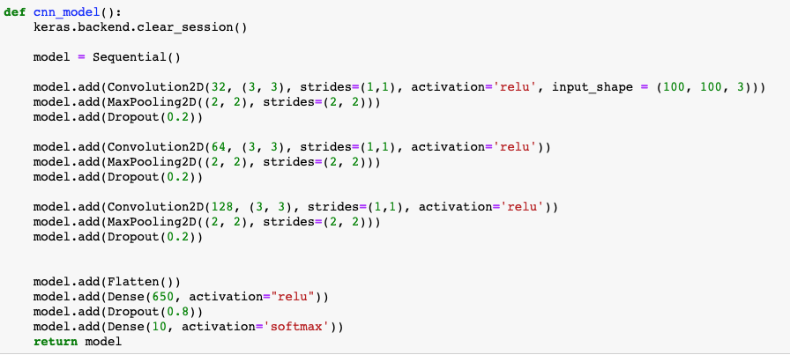
Convolutional Neural Network (CNN)
CNN Architecture
Inspired by VGG_16 model
Increased the numbers by powers of 2 as the layer got deeper
Both Max2DPooling and Dropout were used

Slide 10
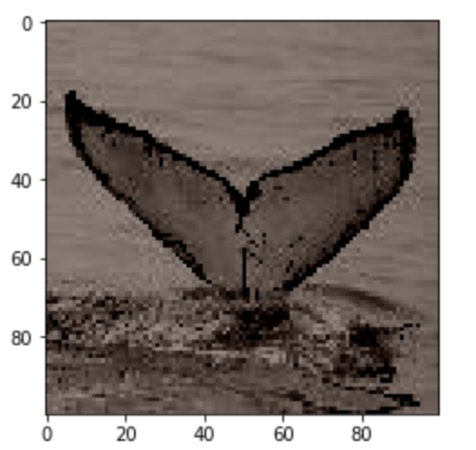
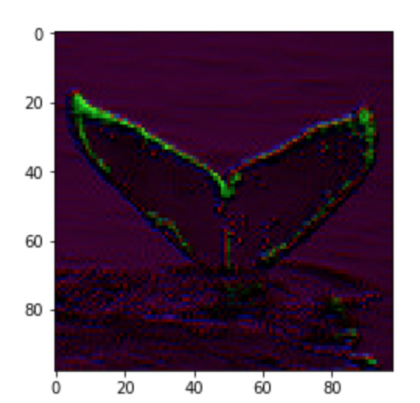
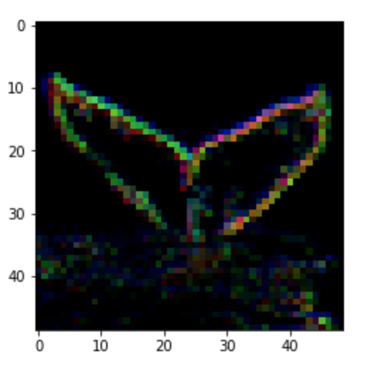
Convolutional Neural Network (CNN)
Original 100x100 image
One (3x3) filter applied to original image
Three (3x3) filter applied to original image (with dropout)

Slide 11
Convolutional Neural Network (CNN)
Data Preparation
Used downsized color images, 100x100x3
Training the Model
Due to memory limitations:
Batch size was set to 64
Epochs to 45
Initial accuracy of 0.71
Accuracy Improvement
Use of image augmentation to increase dataset size
Used Keras library, ImageDataGenerator, for augmentation
Added new images to training set, leaving testing set untouched
Training set size increased from 456 2280
New accuracy of 0.83

Slide 12
Results
Support Vector Machine
Accuracy: 0.43
Convolutional Neural Network (non-augmented images)
Accuracy: 0.71
Convolutional Neural Network (augmented images)
Accuracy: 0.83

Slide 13
Thank You!
Questions?

